Slide 1
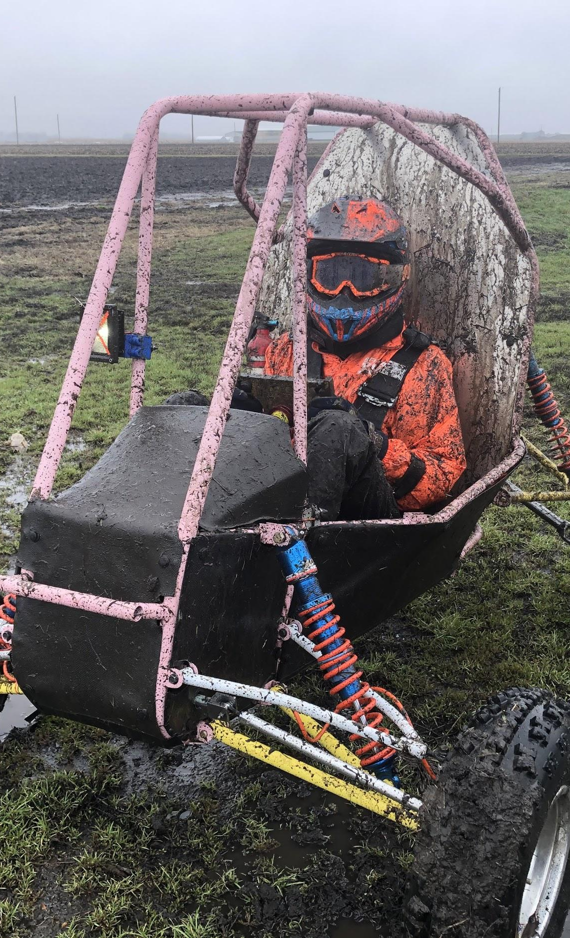

ME 199
4/20/20

Slide 2
Announcements
SAE Updates
The cost event has been modified
We now have to do a formal write-up on one of our parts and how we would change its design and manufacturing processes if the vehicle were to enter production
Cost judges will be picking some teams to give them tips on how to improve
4WD project assignments are coming out

Slide 3
Due Dates
Last Friday (4/17): FMEA was due
FMEA = Failure Modes and Effects Analysis
Please get this done if you have not already!
Message Becca with any questions

Slide 4
Subteam Updates

Slide 5
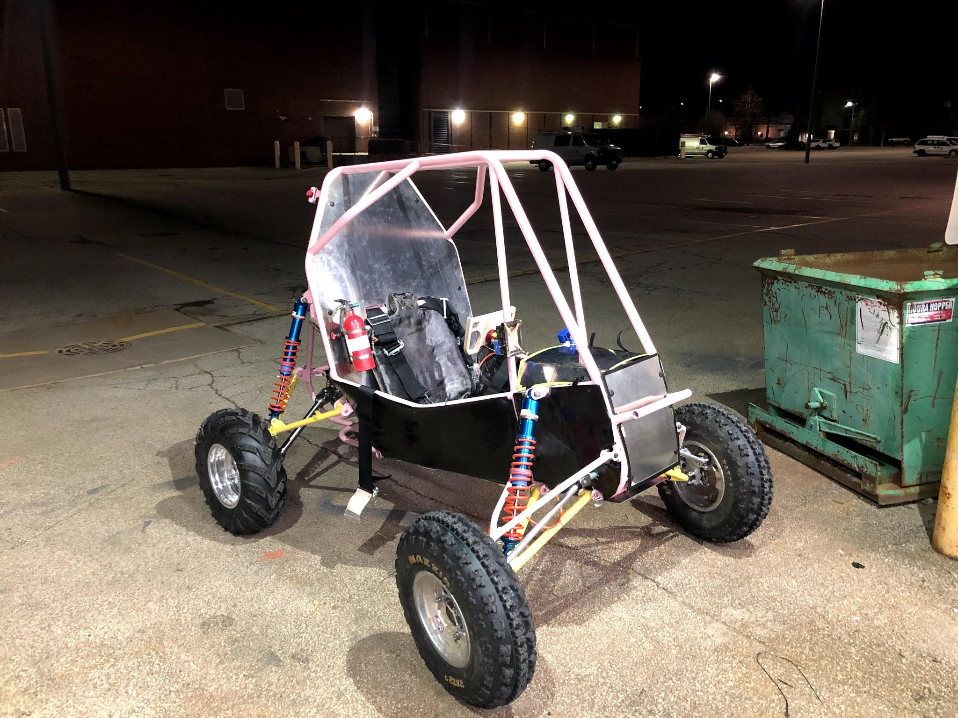
Suspension
Wednesdays at 3pm
Zoom Meeting
199 Projects are in
Thank you all for your hard work and dedication to Jill
Time to focus on 4WD
Expect new project assignments this week
Preliminary points iteration to be released this week
Start designing!

Slide 6
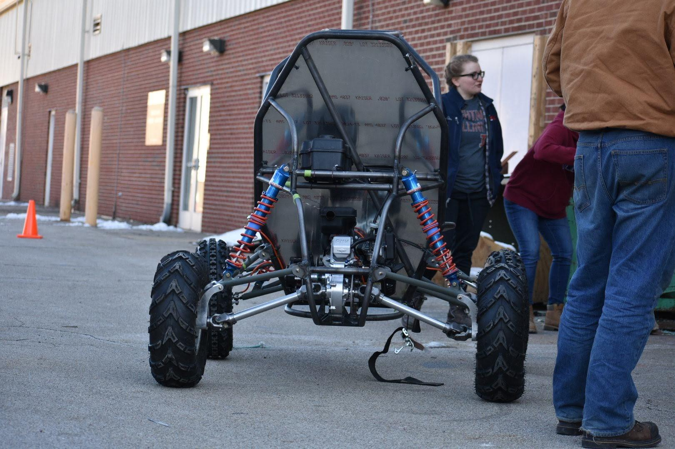
Drivetrain
Wednesdays at 7pm
Zoom Meeting
4WD Projects assigned
More info coming to specific people this week

Slide 7
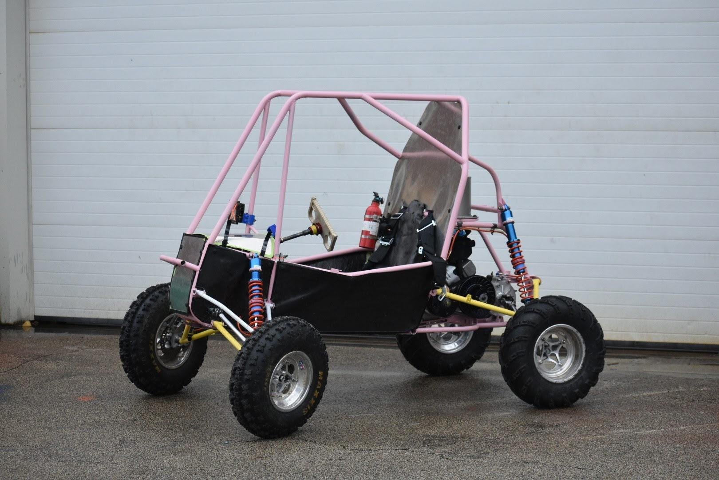
Chassis
Wednesdays at 7pm
Zoom Meeting
4WD projects were assigned earlier this morning
If you did not get a project, but are planning to take ME 199 next year, contact Sam ASAP
Individual meetings will take place this week with part designers to formally introduce projects and give time for any questions to be asked
Closing out ramp redesign and tab testing projects soon

Slide 8
Business
Tuesdays at 6:30pm
Zoom Meeting
No meeting this week
Be prepared for some new assignments that will be assigned at the meeting next week!
Fill out the Google form if you haven’t already
Thank you to those that filled it out early!

Slide 9
Manufacturing
No Meetings right now
The Manufacturing subteam has split into 3 categories
Welding-Lead: Cassie
Machining-Lead: Danielle
Waterjetting-Lead: Cesar
If you are interested in manufacturing and getting extra credit for the next wave of projects (TBD), then message one of the leads
**If you are interested in welding, and have room in your fall schedule, take TSM 233, and get hands on welding practice

Slide 10
ME 199
04.20.20

Slide 11
General Updates
Work is continuing building simulations for 4WD validation
Controller is completed
Working on GGV design
Continuing research for 2021 and validation of ideas
Exploring possibility of attending the Pittsburgh Shootout event on August 1st

Slide 12


MECHANICAL SUBTEAMS
CHASSIS
SUSPENSION
AERODYNAMICS
DRIVETRAIN
INTEGRATION

Slide 13
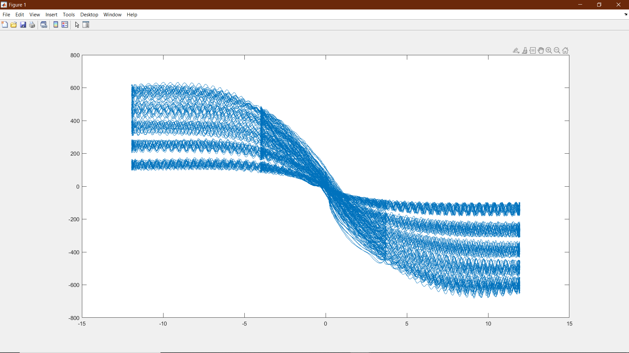
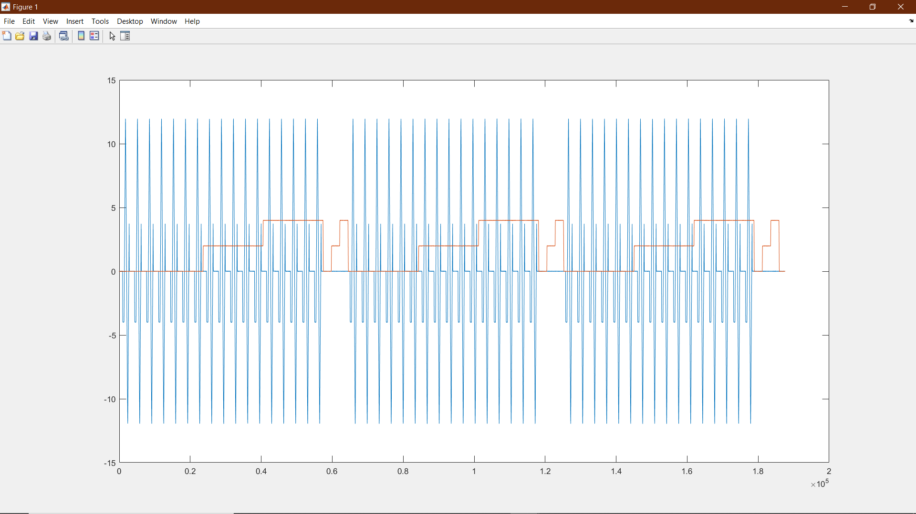
Chassis/Suspension
Kush Patel
kushrp2@Illinois.edu
Last Week
Researched cornering modelling for lap sim
Worked out some small issues with TTC
Had a Suspension Kinematics Tech Talk
This Week
Continue working on TTC Analysis
Create preliminary look up tables
Move towards modeling the magic formula
Complete first integration of lap sim
Based on bicycle model
Simplified equations and modeling
CAD out basic sizing of the corners to get an idea of integration packaging

Slide 14
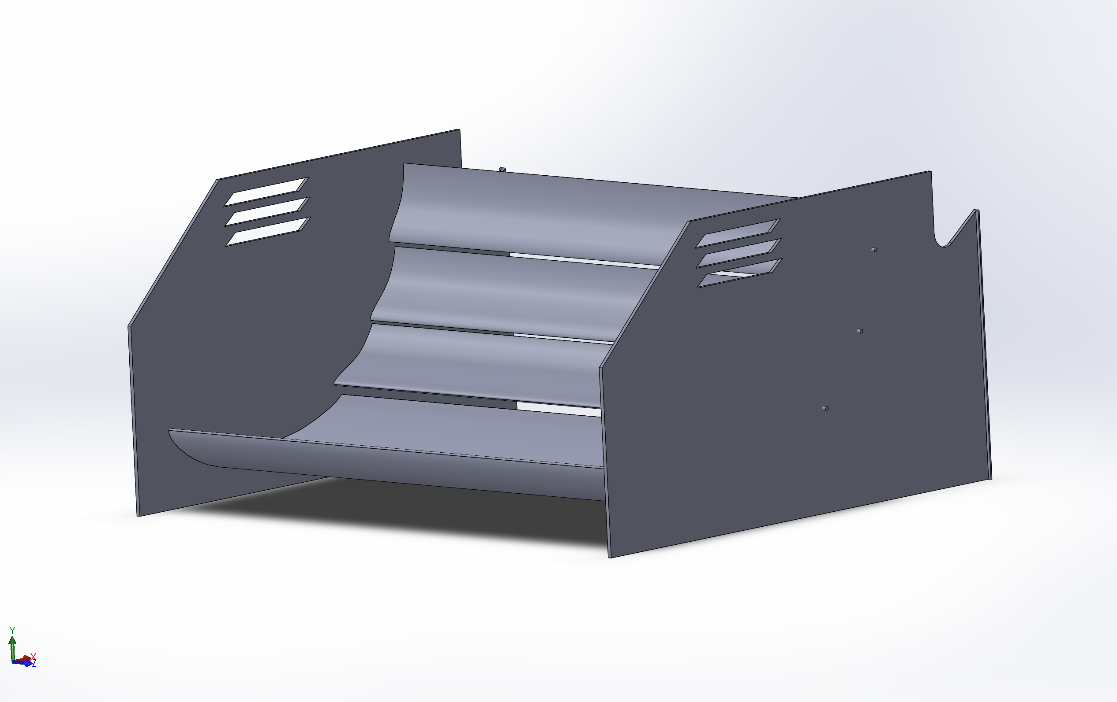
Aerodynamics
Carson Trpik
ctrpik2@illinois.edu
Last Week
Made preliminary designs for testing in CFD
This Week
Continue research for new aero components
Try to fix server (once again)

Slide 15
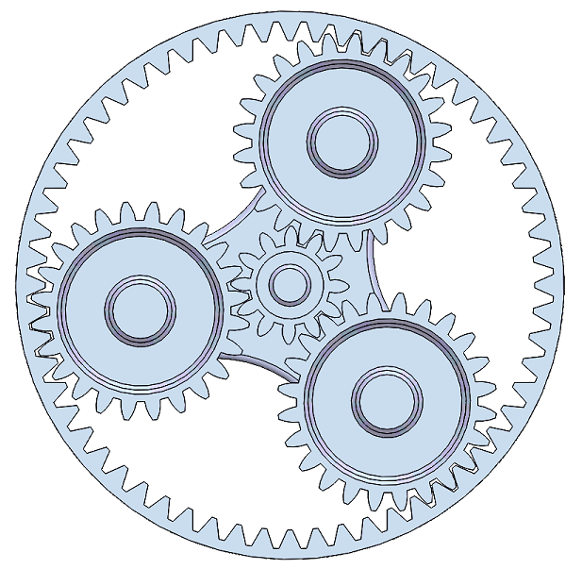
Drivetrain
David Lam
wj6@illinois.edu
Last Week
Worked on 7.25:1 gearbox CAD
This Week
Finish 7.25:1 gearbox CAD
Continue researching and writing code for lap sim

Slide 16
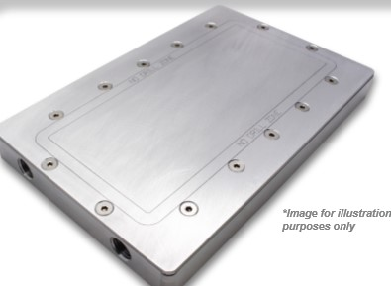
Integration
Rishi Taparia
taparia2@illinois.edu
Last Week
Figured out radiator and fan combinations
This Week
Look into possible custom coldplate design

Slide 17


ELECTRICAL SUBTEAMS
TRACTIVE
DAQA
MOTORS
CONTROLS

Slide 18
Tractive System
Evan Chen
evanc4@Illinois.edu
Last Week
Completed controller for lap sim in Matlab
Generates lateral accel, longitudinal velocity, longitudinal accel profiles given track radii and GGV diagrams
This Week
Work on generating GGV diagrams for lap sim
Look into BMS slave board layout
Possible to use 12 of the same board designs, or is two designs necessary?

Slide 19
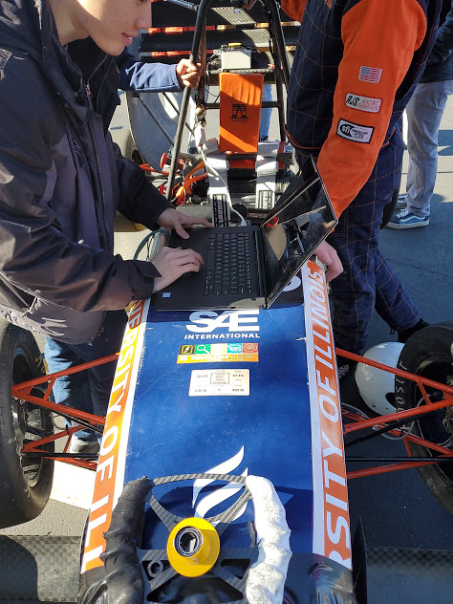
Data Acquisition
Joe Lopez
Joseal2@illinois.edu
Last Week
Sensor fusion trials from 2019 car data
This Week
Continue board redesign
Continue sensor fusion
Basic vue demonstration with selection of data

Slide 20
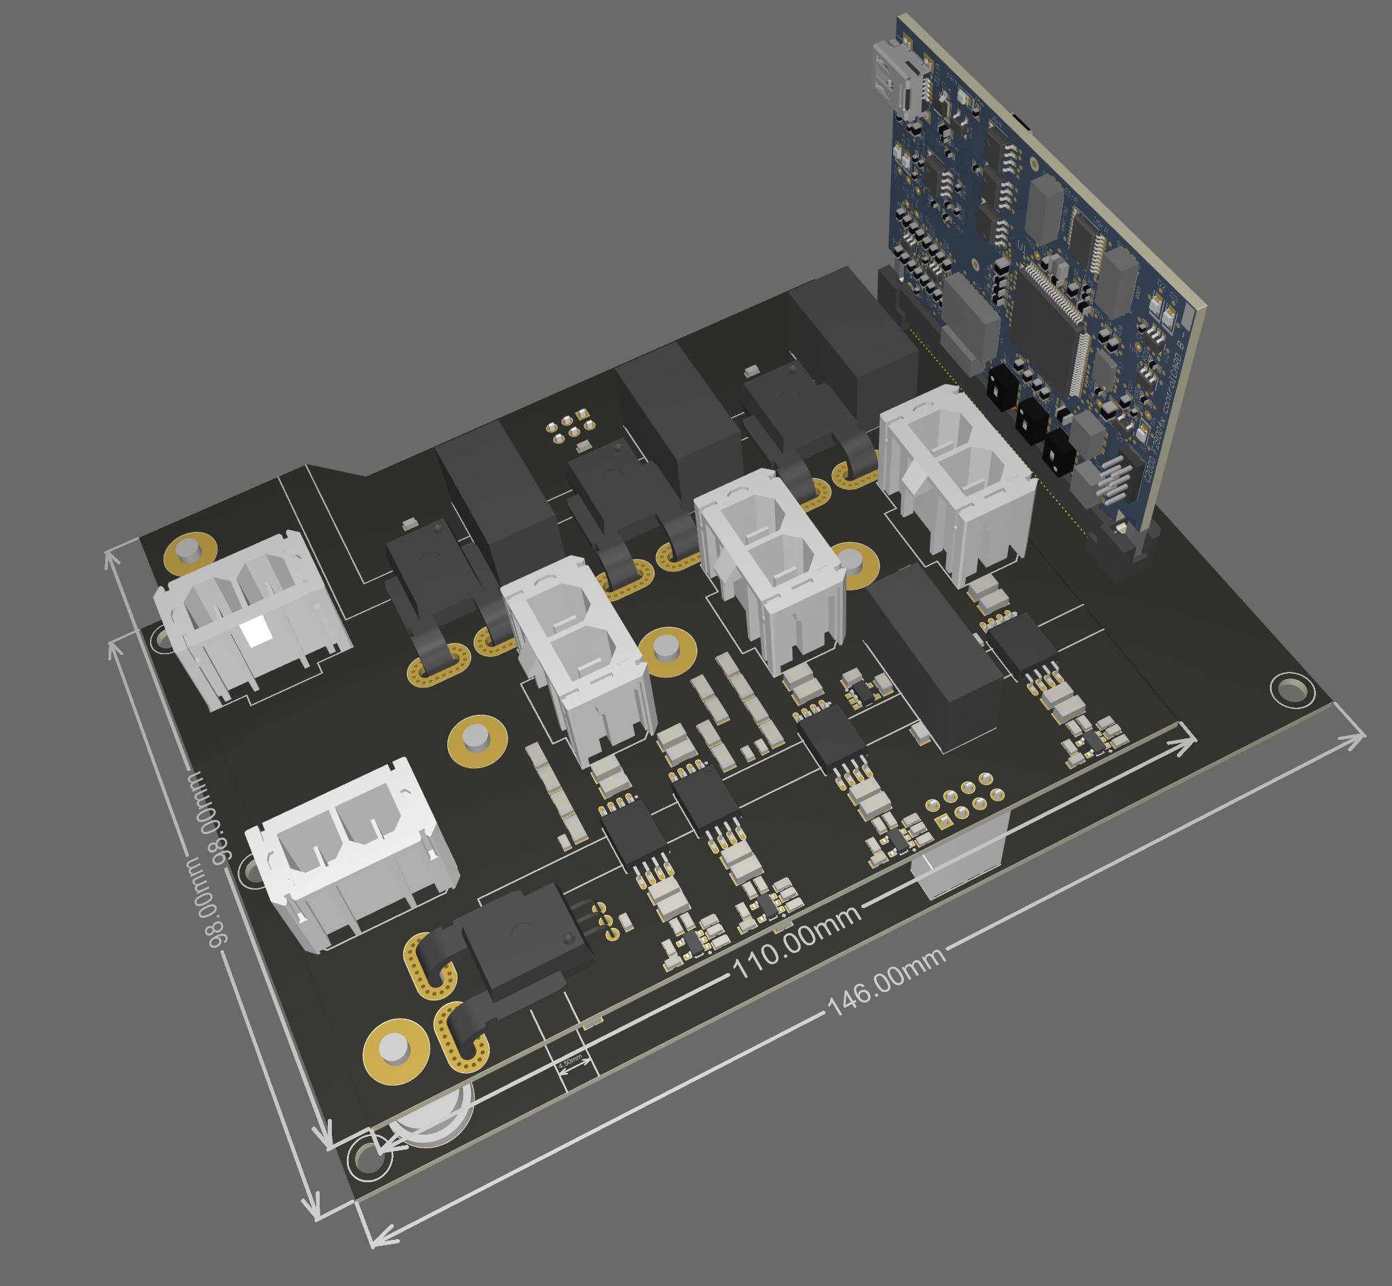
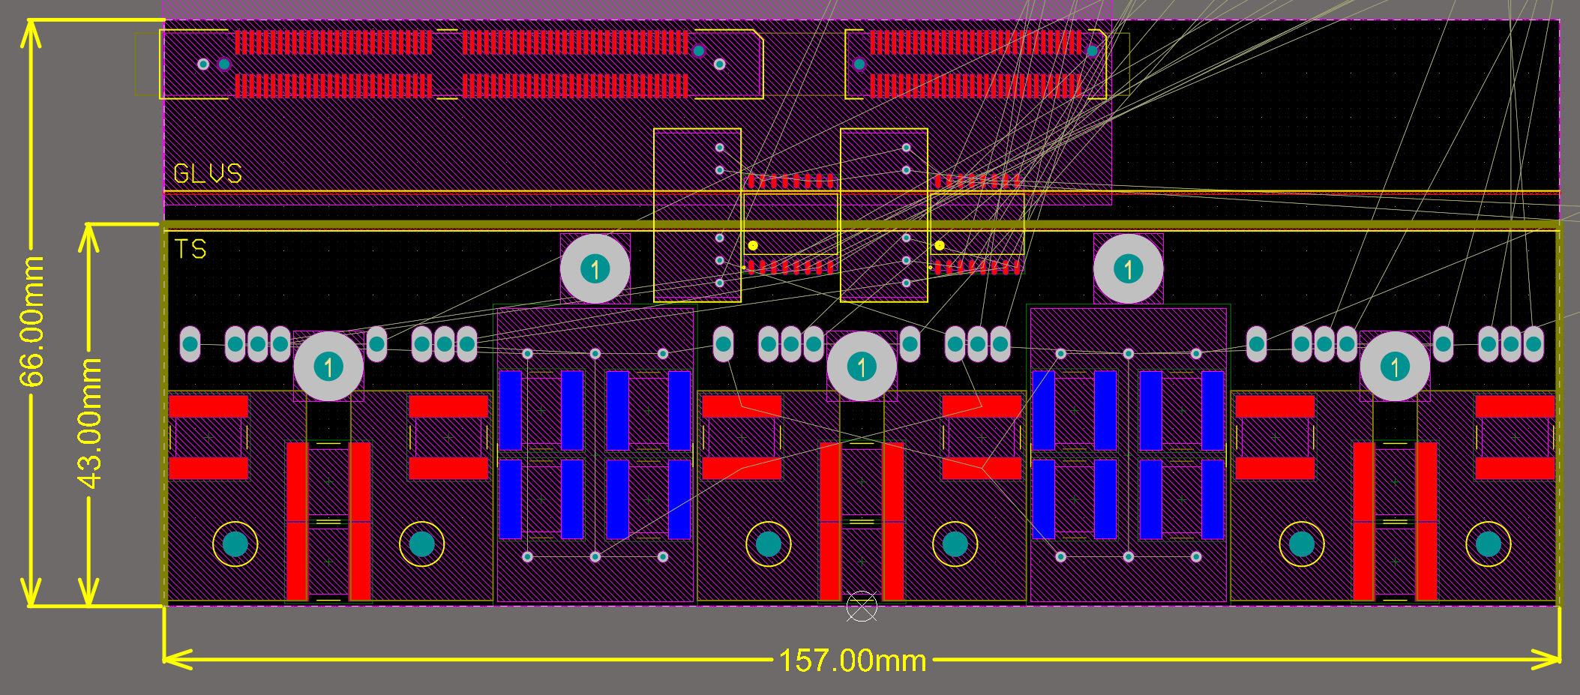
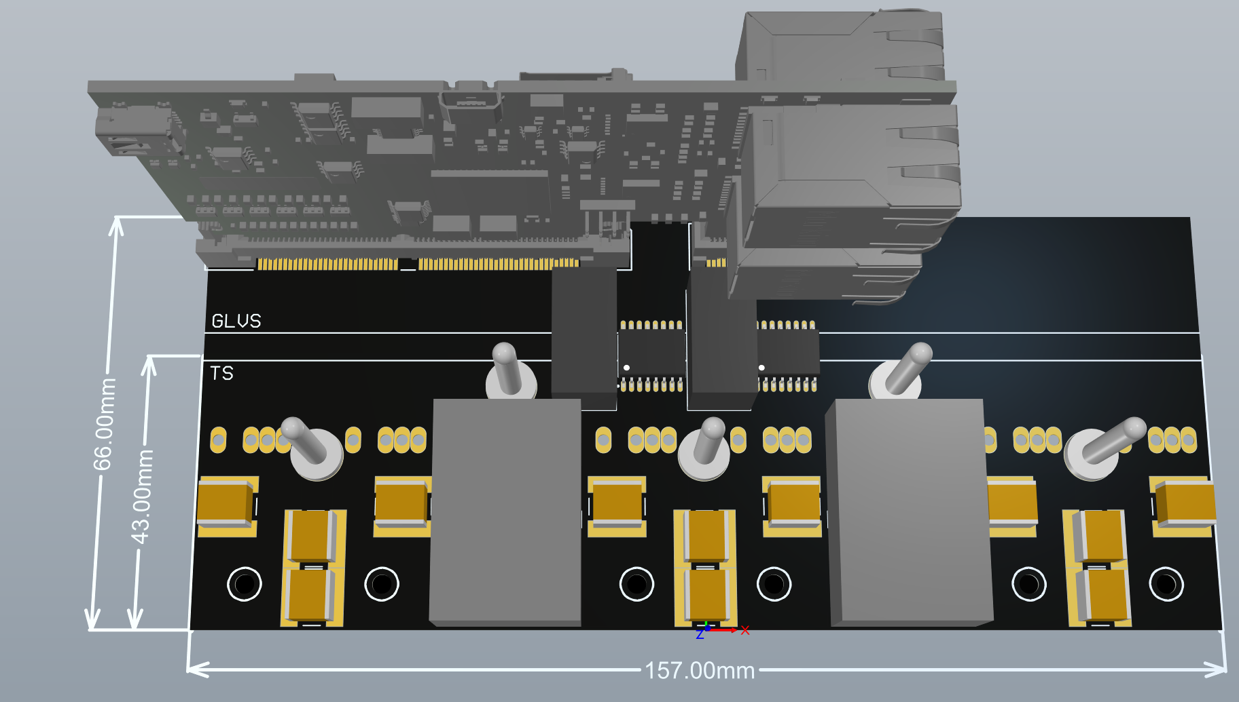
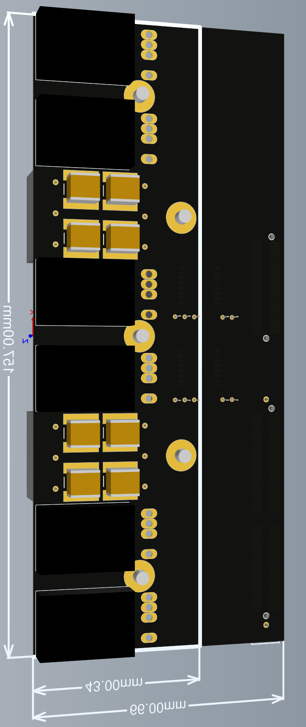
Motors/Controls
Chaitanya Sindagi
sindagi2@illinois.edu
Last Week
Discussions with prof and industry experts, design looks good
Love the S/D sensing for noise immunity
Layout leaves some to be desired
Completely new layout considered that’s ~40% smaller and makes cold-plate much lighter
This Week
Evaluate new layout
Separation b/w HV and LV
Stiffer DC Bus
Smaller, lighter
New and requires lots of work
Finalize design layout and start routing

Slide 21

BUSINESS SUBTEAM

Slide 22
Business
Last Week
Researched information for business presentation
Added to the presentation
Placed T-Shirt order
This Week
Continue researching for business presentation
Continue working on business presentation

Slide 23
QUESTIONS?

Slide 24
Blaine Hesler
ME199
4/20/2020

Slide 25
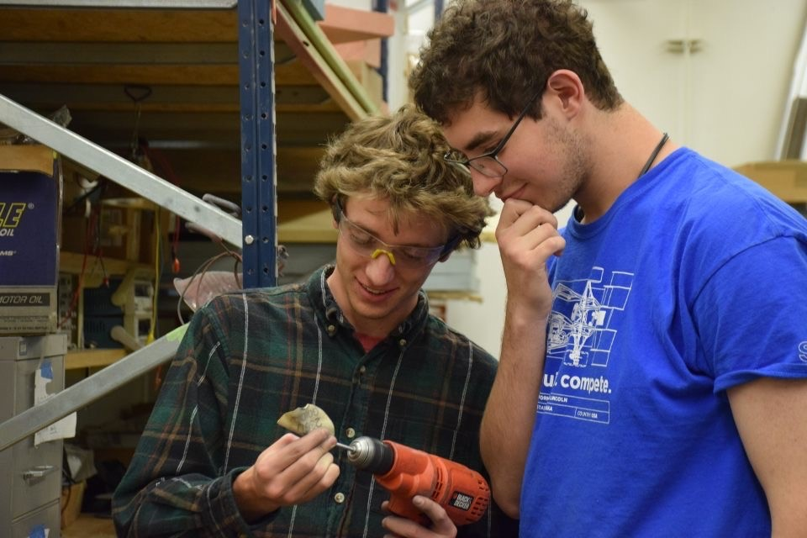
Blaine Hesler
Joined Illini Motorsports in Fall 2019
Systems Engineering 2023
Member of Aero/Composites subsystems

Slide 26
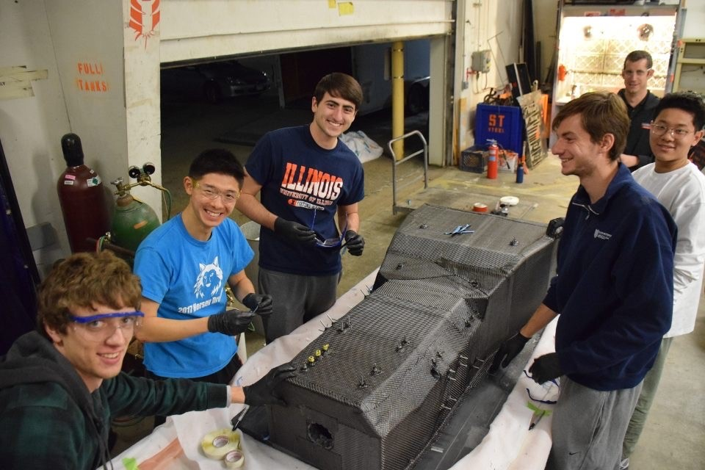
Team Involvement
Helped with the undertray mold prep and layup
Helped with the monocoque layups and core placement
Did lots of sanding on the aero elements on the car
Assisted with many of the team’s layups

Slide 27
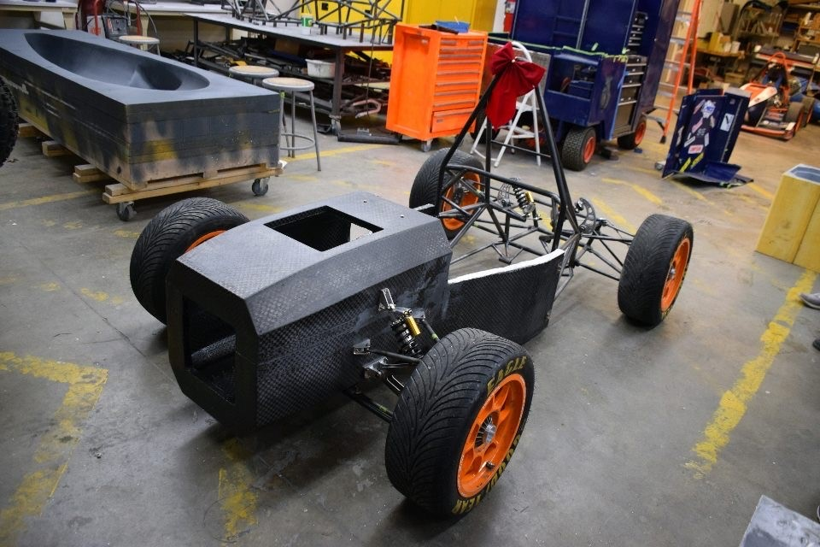
New Opportunities
Got to help with some NDT
Help the team during testing sessions
Work with advanced materials and manufacturing methods
Listen to talks from industry professionals
Learn and work with a very gifted team of engineers

Slide 28
Diego Zuniga
Mechanical Engineering 2023
Joined Illini Motorsports in Spring 2019
Drivetrain Subsystem Member

Slide 29
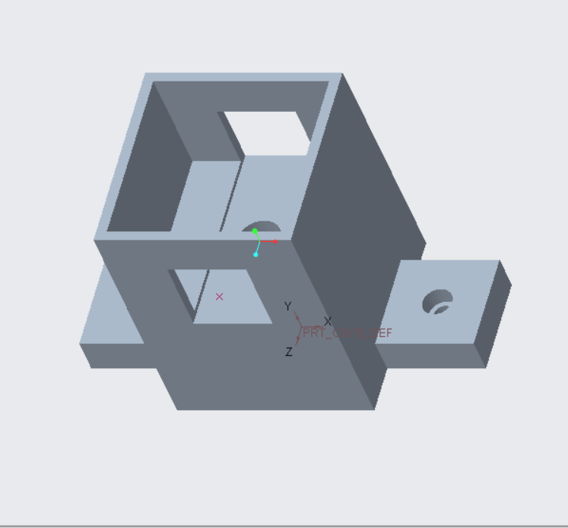
Experience on Drivetrain
Drivetrain Team
Helped Remzo with dyno in Mechse West
Made stand for Pressure gauge on dyno (pictured on the right)
Helped adjust dyno and switch out engines on it
Helped bleed brakes

Slide 30
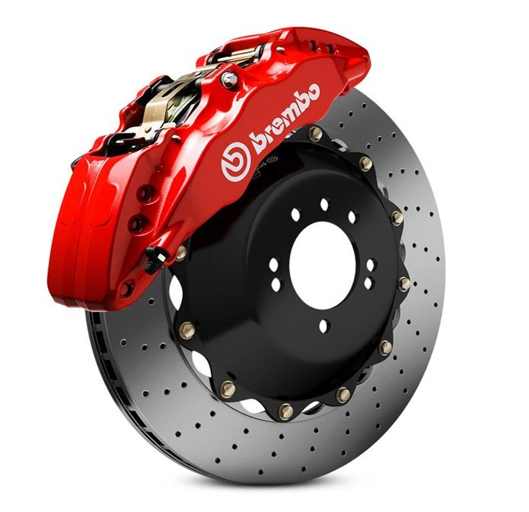
Knowledge from Drivetrain
Deeper understanding of how the drivetrain system works
Why bleeding the brakes is necessary
How the brake lines work
How to test out different parts of the drivetrain system

Slide 31
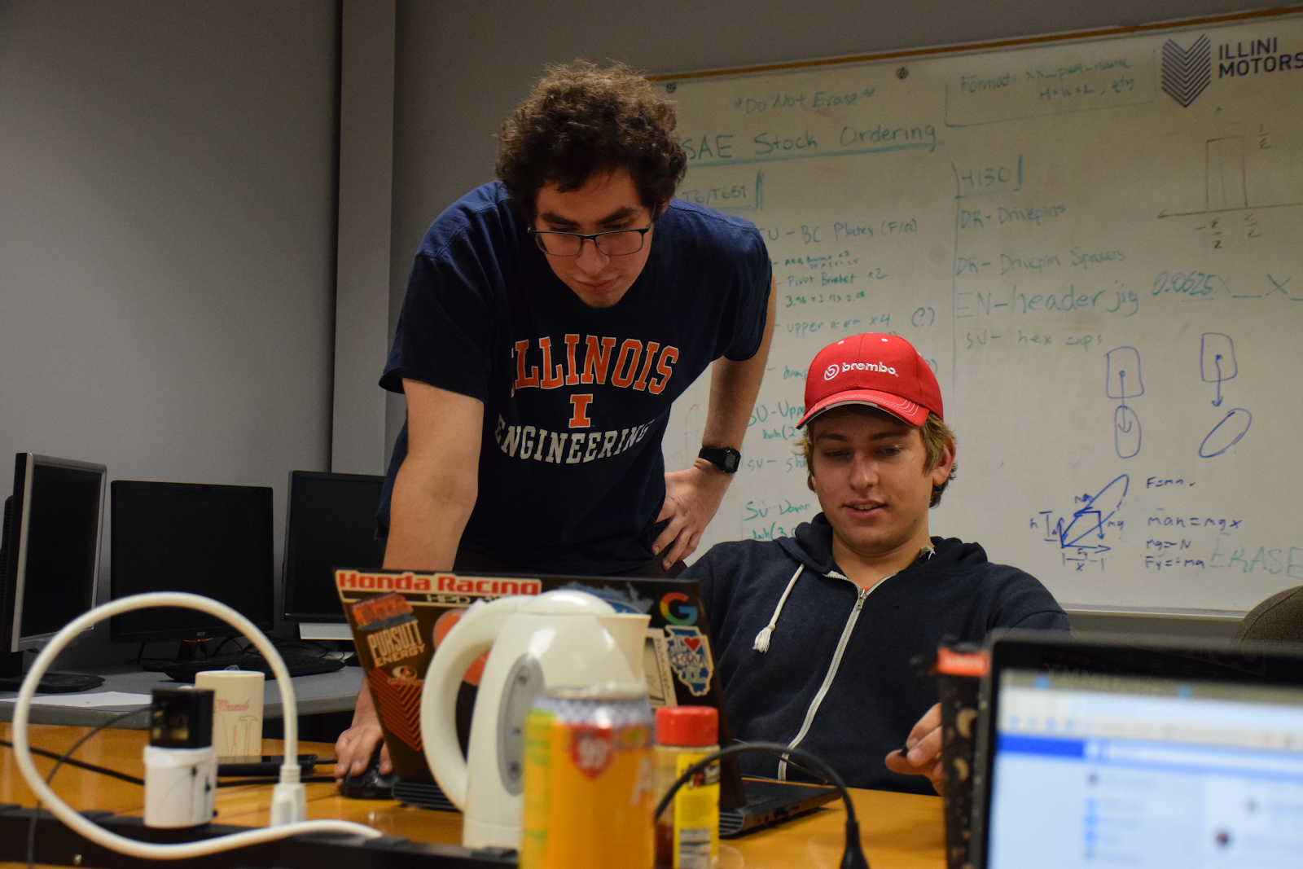
Ben Cross
Electrical Engineering ‘21
Joined Illini Motorsports in Fall 2017
Involved with the Electronics Subsystem since
2017-2018: Electronics Team Member
2018-2019: Electronics Project Lead
2019-2020: Electronics Subsystem Lead

Slide 32
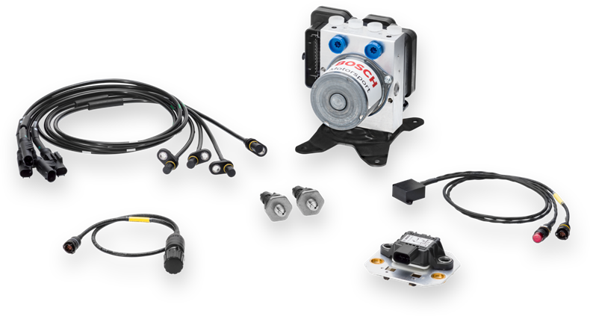
Electronics Team Member
Assisted with and learned about general manufacturing of wiring harnesses
Responsible for integrating the Bosch ABS unit with all of the existing electronics
Learned the basics of PCB design

Slide 33
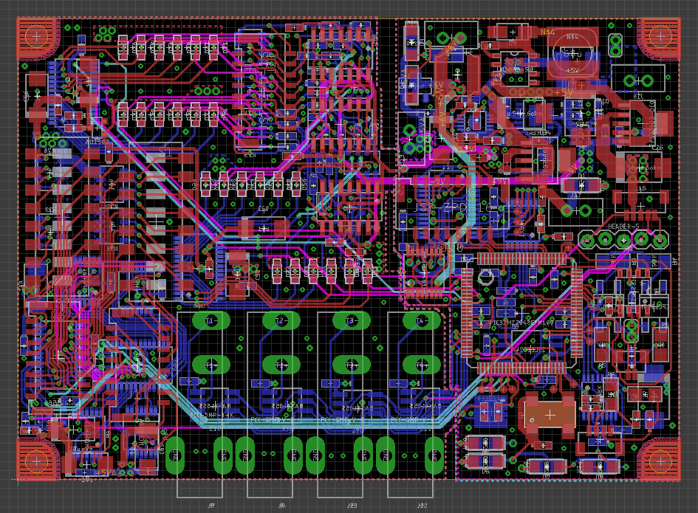
Electronics Project Lead
Manufactured and tested the car’s CAN harness
Assisted with other harnesses
In charge of redesigning the Sensor Processing Module
Manufactured the PCB
Wrote the software needed for the board to work
Performed hardware/software testing

Slide 34
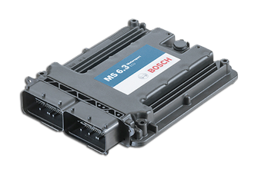
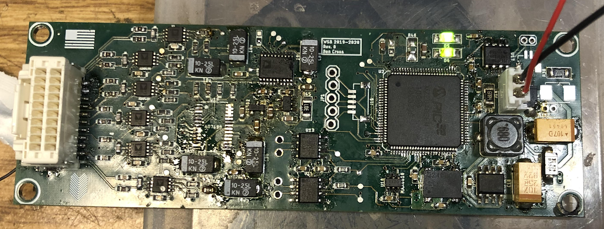
Electronics Subsystem Lead
Coordinated all hardware and software design efforts for the 2019-2020 car
Responsible for the electrical integration of the new MS6 ECU
Designed modular strain gauge/thermocouple DAQ boards
Assisted in the implementation of our new wireless telemetry
Facilitated the training of new members in PCB design and general manufacturing practices

Slide 35
Overall Skills/Lessons Learned
Practical electronics skills
PCB design/design for manufacturability
Debugging (both hardware and software)
Embedded C programming (i.e. working with microcontrollers)
Manufacturing of electronics and electronic components
Surface mount and through hole soldering
Fabrication of wiring harnesses
Collaborating on cross-disciplinary design and integration challenges
Invaluable engineering communications skills

